Slide 1
Projection of Points

Slide 2
ORTHOGRAPHIC PROJECTIONS OF POINTS
TO DRAW PROJECTIONS OF ANY OBJECT, ONE MUST HAVE FOLLOWING INFORMATION
OBJECT
{ WITH IT’S DESCRIPTION, WELL DEFINED.}
OBSERVER
{ ALWAYS OBSERVING PERPENDICULAR TO RESP. REF.PLANE}.
LOCATION OF OBJECT,
{ MEANS IT’S POSITION WITH REFFERENCE TO H.P. & V.P.}
TERMS ‘ABOVE’ & ‘BELOW’ WITH RESPECTIVE TO H.P.
AND TERMS ‘INFRONT’ & ‘BEHIND’ WITH RESPECTIVE TO V.P FORM 4 QUADRANTS.
OBJECTS CAN BE PLACED IN ANY ONE OF THESE 4 QUADRANTS.
IT IS INTERESTING TO LEARN THE EFFECT ON THE POSITIONS OF VIEWS ( FV, TV ) OF THE OBJECT WITH RESP. TO X-Y LINE, WHEN PLACED IN DIFFERENT QUADRANTS.

Slide 3
NOTATIONS
Following notations should be followed while naming Different views in orthographic projections.
View | Point | Line
TOP VIEW | a | a b
FRONT VIEW | a’ | a’ b’
SIDE VIEW | a” | a” b”
Same system of notations should be followed Incase numbers, like 1, 2, 3 – are used.

Slide 4






VP
₂nd
Quad.
1ST Quad.
Y
Observer
X Y
HP
X
₃rd
Quad.
4th Quad.
THIS QUADRANT PATTERN,
IF OBSERVED ALONG X-Y LINE ( IN RED ARROW DIRECTION) WILL EXACTLY APPEAR AS SHOWN ON RIGHT SIDE AND HENCE,
IT IS FURTHER USED TO UNDERSTAND ILLUSTRATION PROPERLLY.

Slide 5
Projection of Point
A point may be situated, in space, in any one of the four quadrants formed by the two principal planes of projection or may lie in any one or both of them.
Its projections are obtained by extending projectors perpendicular to the planes.
One of the planes is then rotated so that the first and third quadrants are opened out. The projections are shown on a flat surface in their respective positions either above or below or in xy.

Slide 6
Projection of Point in different quadrants
The point is situated in the first quadrant.
The point is situated in the second quadrant.
The point is situated in the third quadrant.
The point is situated in the fourth quadrant.

Slide 7
Point A is Placed In different quadrants
POINT A IN 2ND QUADRANT
A
VP
a’
POINT A IN 1ST QUADRANT
VP
A
a’
a
and it’s Fv & Tv
are brought in same plane for
HP
OBSERVER
Observer to see
HP
clearly.
OBSERVER
Fv is visible as
it is a view on
a
VP. But as Tv is is a view on Hp,
it is rotated downward 90⁰, In clockwise direction.The In front part of
a
Hp comes below
xy line and the part behind Vp comes above.
HP
HP
OBSERVER
OBSERVER
Observe and note the process.
a
a’
a’
A
POINT A IN
A
POINT A IN
₃RD
QUADRANT
VP
₄TH
QUADRANT
VP

Slide 8
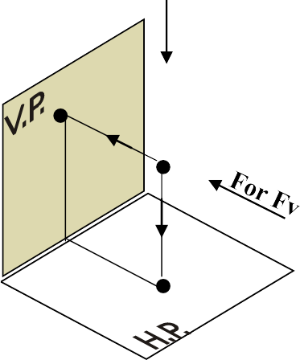
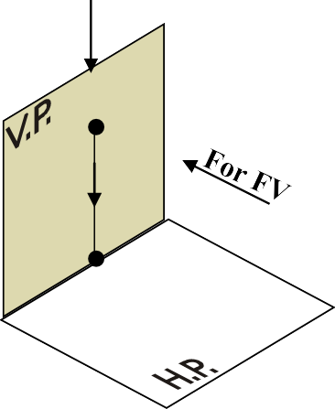
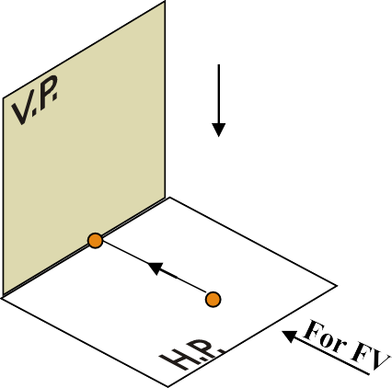



PROJECTIONS OF A POINT IN FIRST QUADRANT.
POINT A ABOVE HP & INFRONT OF VP
POINT A ABOVE HP & IN VP
POINT A IN HP & INFRONT OF VP
For TV
For TV
PICTORIAL PRESENTATION
PICTORIAL PRESENTATION
For TV
a’
a’ ^{A}
A
Y
Y
Y
a
a’
X
a
A
a
X
X
ORTHOGRAPHIC PRESENTATIONS
OF ALL ABOVE CASES.
FV above xy, TV below xy.
Fv above xy, Tv on xy.
Fv on xy, Tv below xy.
VP
VP
VP
a’
a’
X
Y
X
Y
X
a’
Y
a
a
a
HP
HP
HP

Slide 9
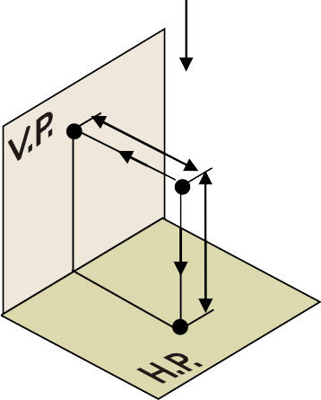
PROJECTION OF POINT IN 1ST QUADRANT
If a point is above HP and in front of VP then it is situated in the 1st quadrant
For TV
FV above xy, TV below xy.
a’
25
VP
a’
A
Y
30
30
x
y
X
a
25
a
HP
General Observations
When HP is rotated by 90º in clockwise direction then HP (TV) will move below xy line.
FV (a’) will be above the xy axis while TV (a) will be below the xy axis.
Vertical distance from HP will be visible in FV while horizontal distance from VP will be visible in TV.

Slide 10
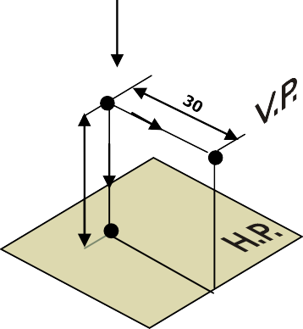
PROJECTION OF POINT IN 2nd QUADRANT
If a point is above HP and behind VP then it is situated in the 2nd quadrant
For TV
FV above xy, TV below xy.
A
a’
VP
HP
a
25
a
Y
a’
30
25
x
y
X
General Observations :-
When HP is rotated by 90º in clockwise direction then HP (TV) will move above xy line. VP (FV) and HP (TV) will overlap each other and will be above xy line.
FV (a’) and TV (a) both will be above the xy line.
Vertical distance from HP will be visible in FV while horizontal distance from VP will be visible in TV.

Slide 11


PROJECTION OF POINT IN 3rd QUADRANT
If a point is below HP and behind VP then it is situated in the 3rd quadrant
For TV
TV above xy, FV below xy.
HP
a
a
Y
20
40
x
y
X
A
a’
40
20
a'
VP
General Observations
FV (a’) will be below the xy axis while TV (a) will be above the xy axis.
Vertical distance from HP will be visible in FV while horizontal distance from VP will be visible in TV.
Point is denoted by capital letter while its views are denoted by small letters.

Slide 12
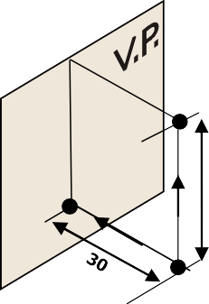
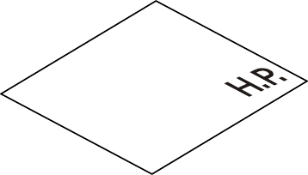
PROJECTION OF POINT IN 4th QUADRANT
If a point is below HP and in front of VP then it is situated in the 4th quadrant
For TV
FV above xy, TV below xy.
Y
X
x
y
a
25
a'
30
25
a
HP
a’
A
VP
General Observations :-
When HP is rotated by 90º in clockwise direction then HP (TV) will move below xy line. VP (FV) and HP (TV) will overlap each other and will be below xy line.
FV (a’) and TV (a) both will be below the xy line.
Vertical distance from HP will be visible in FV while horizontal distance from VP will be visible in TV.

Slide 13
1. Draw the projections of the following points on the same ground line, keeping the projectors 25
mm apart.
A, in the H.P. and 20 mm behind the V.P.
B, 40 mm above the H.P. and 25 mm in front of the V.P C, in the V.P. and 40 mm above the H.P.
D, 25 mm below the H.P. and 25 mm behind the V.P.
E, 15 mm above the H.P. and 50 mm behind the V.P.
F, 40 mm below the H.P. and 25 mm in front of the V.P. G, in both the H.P. and the V.P.
e
b’
c'
d
a
30
40
40
20
25
e’
15
g, g’
x
a'
c
y
25
25
15
40
f f’
25
b
d'
25
25
25
25
25

Slide 14
Prob.2. A point P is 15 mm above the H.P. and 20 mm in front of the V.P. Another point
Q is 25 mm behind the V.P. and 40 mm below the H.P. Draw projections of P and Q keeping the distance between their projectors equal to 90 mm. Draw the straight lines joining (i) their top views and (ii) their front views.
q
p’
25
15
x
y
20
p
40
q'
90

Slide 15
Prob.3. The two points A and B are in the H.P. The point A is 30 mm in front of the V.P.,
while B is behind the V.P. The distance between their projectors is 75 mm and the line joining their top views makes an angle of 45⁰ with xy. Find the distance of the point B from the V.P.
b
45
a'
x
y
b'
30
45º
a
75

Slide 16
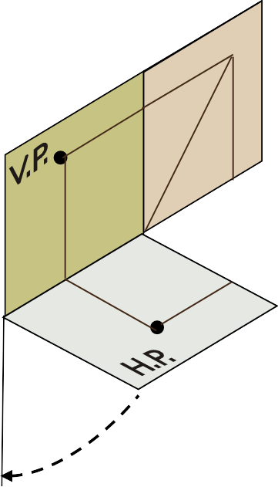

Prob.4. A point A is situated in the first quadrant. Its shortest distance from the intersection point of HP and VP is 60 mm and it is equidistant from the principal planes. Draw the projections of the point and determine its distance from the principal planes.
For TV
a’’
a’
a’
PP
A
a'’
60
X
X
a
a
a’’
x₁
a’
VP
a’
PP
a’’
PP
42
x
45º
y
X
42
a
HP
a
HP
y₁

